Slide 1
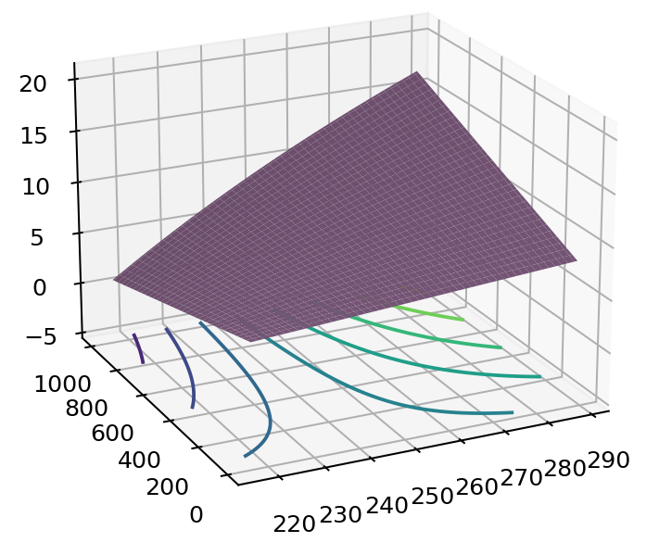


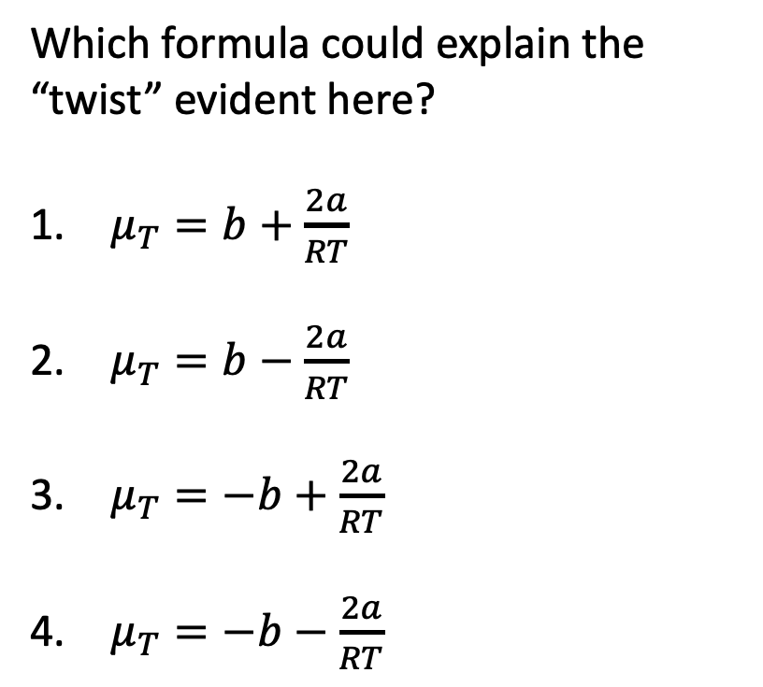
Across weeks – $H(T,P)$ as a thermodynamic surface
$$H$$
Which formula could explain the “twist” evident here?
$μ_{T}=b+\frac{2a}{RT}$
$μ_{T}=b−\frac{2a}{RT}$
$μ_{T}=−b+\frac{2a}{RT}$
$μ_{T}=−b−\frac{2a}{RT}$
P
T
$$dH=C_{P}dT+μ_{T}dP$$

Slide 2
Week 7 – Interpreting thermodynamic surfaces 2
$$H$$
Looks like 240 K is the
Critical temperature
Boyle temperature
Boiling temperature
Inversion temperature
H
P
T
$$dH=C_{P}dT+μ_{T}dP$$

Slide 3
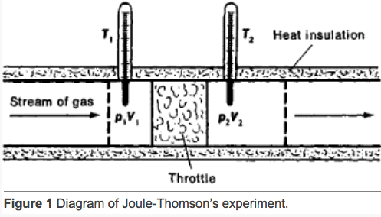
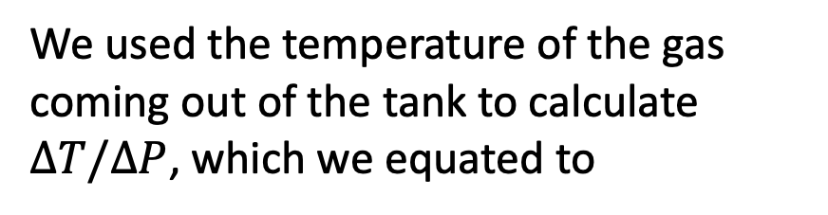
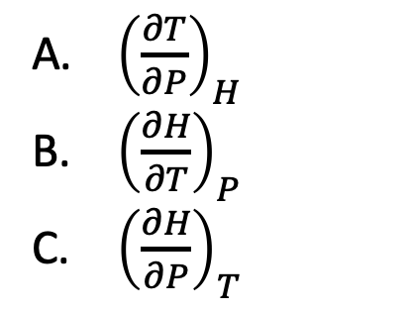
Week 7 – The adiabatic J-T experiment
$$H$$
H
We used the temperature of the gas coming out of the tank to calculate $∆T/∆P$, which we equated to
P
T
${\left(\frac{∂T}{∂P}\right)}_{H}$
${\left(\frac{∂H}{∂T}\right)}_{P}$
${\left(\frac{∂H}{∂P}\right)}_{T}$
$$dH=C_{P}dT+μ_{T}dP$$

